Slide 1

Environmentally-induced Migration (EIM)
Discussion and Recommendations
May 10, 2012

Slide 2
Environmentally-induced Migration (EIM)
1. Introduction
2. Realities
3. Concerns
4. Recommendations

Slide 3
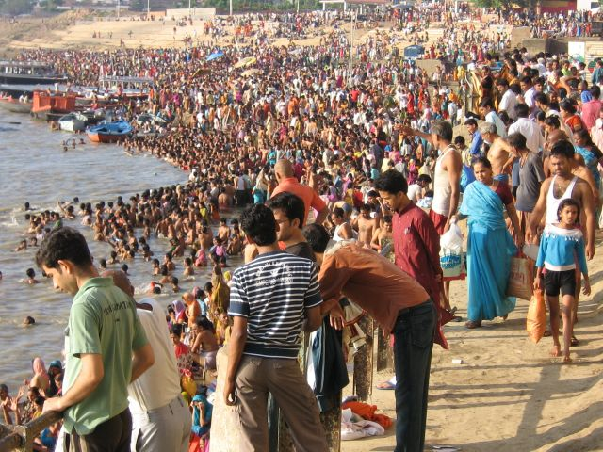
The Asia-Pacific region is highly exposed to environmental risks, having by far the highest population density of any continent. ADB Report

Slide 4
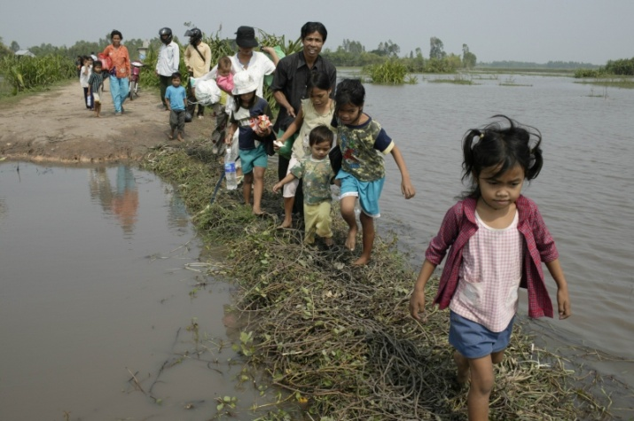
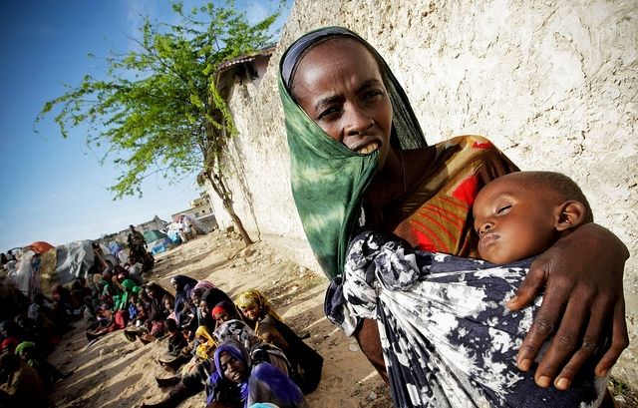
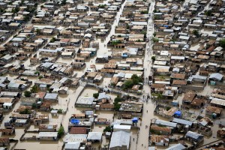
Behind the numbers and statistics there are persons and whole populations that suffer.

Slide 5
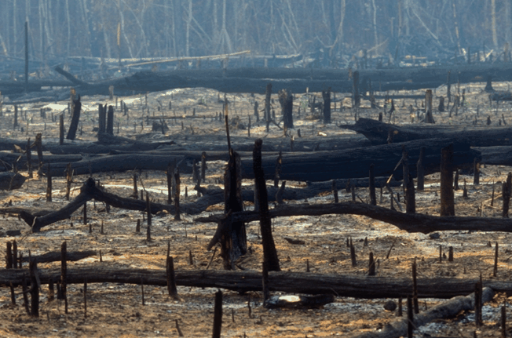
Russian heat wave, 2010 – World wheat prices increased
60% over two months.

Slide 6

Pakistan flooding, 2010: 2,000 people killed; a million livestock drowned; 6 million acres of cropland damaged ; roads, bridges, livelihoods disappeared.

Slide 7
Environmentally-induced Migration (EIM)
Discussion Paper and Recommendations

Slide 8
According to the IOM World Migration Report 2011:
about 214 million persons in the world today have migrated to countries other than their own, and
around 740 million persons have migrated within their countries
Roughly, one in seven of the world’s population is a migrant.
“Failing ecosystems, vulnerability to natural hazards and disasters, gradual climate-driven environmental degradation are putting pressure on human migration and can lead to a future crisis in sustainable development.”
Areikat, S. & Milan, A. Environmentally induced migration and sustainable development. (2010)

Slide 9
Realities of Environmentally-induced Migration
.
For decades, many migrants have moved from mountainous and rural areas to urban centers because of economic, social, political, demographic, and environmental factors: lack of fertile soil, soil erosion, environmental degradation, water scarcity, floods, and natural disasters
Particularly critical in some low-lying countries is costal flooding caused by rising sea levels
The percentages of dry lands affected or threatened by desertification are the following: 43% in Africa, 65% in West Asia (i.e., Bahrain, Iraq, Jordan, Kuwait, Lebanon, Oman, Palestine, Qatar, Saudi Arabia, Sudan, Syria, Yemen, United Arab Emirates)
Black, R. & Bennett, S. R. G. Migration and global environmental change: priorities for policymakers, (Dec. 2011 – Jan. 2012), Migration Policy Pratice 1(2).

Slide 10
Realities of Environmentally-induced Migration
.
Lack of attention to sustainable development and resulting environmental changes will most likely exacerbate both sudden- and slow-onset disasters and environmental degradation with the result that increasingly people will be forced to migrate – some to places already environmentally compromised already.
Other people, usually those affected by extreme poverty, cannot move from dangers at all.

Slide 11
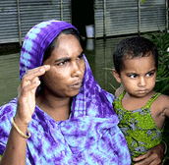
Women, who comprise two-thirds of the agricultural sector in developing countries, and more than 90 percent in many African countries, are among the most vulnerable to effects of climate change and to forced migration.
In this context, there is a growing need to address the issue of sustainability and the equally critical need for capacity building, in order to anticipate and address the now unavoidable environmental changes already underway and their relationship to human mobility.
UN WomenWatch, Women, gender equality and climate change (2009), Web, http://www.un.org/womenwatch/feature/climate_change/

Slide 12
Concerns about Environmentally-induced Migration
A growing concern about EIM is uncoordinated coping strategies by states, resulting in population displacement, competition for scarce resources, and increased likelihood for violence
An increasing concern is statelessness due to resource scarcity, overcrowding, and displacement from sea-level rise affecting coastal areas and islands.
A stateless person is not recognized as a citizen by any state. Citizenship often enables people to obtain health care, employment, housing, and education, as well as provides voting rights and the ability to enter and exit a nation freely. Open Society Institute, Web, http://www.soros.org/indepth/stateless

Slide 13
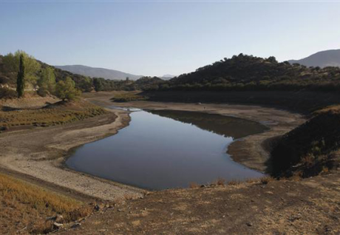
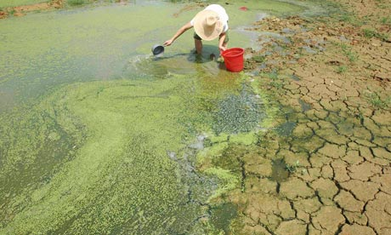
Concerns about Environmentally-induced Migration
Reduced availability of clean water has led to water stress for hundreds of millions of people;
decreasing crop yields are placing tens of millions of people at risk of hunger and the likelihood of forced migration.

Slide 14
Concerns about Environmentally-induced Migration
The effects of climate change have caused a negative overall impact on human health, especially for older persons, the young, people living in extreme poverty, and other marginalized populations, calling for new adaptations and new policies that support these adaptations
Similarly, adjustments and policy adaptations are needed for children’s education, which is impaired by the impact of environmental changes such as floods and drought

Slide 15
Concerns about Environmentally-induced Migration
Further drivers of EIM occur as migrants arrive in areas which are already struggling with negative effects of environmental change, such as urban slums and dangerous coastal areas, which are often overextended and unable to effectively absorb migrants.
A critical concern is human trafficking, especially of women and children who are forced to move out of their social-cultural surroundings and are very vulnerable to labor exploitation and sexual violence.

Slide 16
Migration, as one form of adaptation to the effects of climate change, will always exist. Given this reality, here are some proposed recommendations, which consider both the adaptation to, and mitigation of, effects of unsustainable social, economic, and environmental habits and policies:

Slide 17
Recommendations
To Address Environmentally-induced Migration
Coordination of coping strategies by States regarding:
  Enhancement of livelihoods through the development of green jobs, sustainable fisheries, provision of sustainable infrastructure and services, and sustainable agricultural development
  Adoption of policies that facilitate sustainable production and consumption
  Urban planning that takes environmentally-induced migration to cities into account

Slide 18
Recommendations
To Address Environmentally-induced Migration
Coordination of coping strategies by States regarding:
Participation in decision making by all stakeholders, especially migrant populations and indigenous peoples
Facilitation of equitable distribution of benefits by means of a Social Protection Floor providing: community-level insurance and individual micro-insurance; social protection via conditional cash transfers, and government-subsidized index insurance

Slide 19
Recommendations
To Address Environmentally-induced Migration
2. Admission of environmental migrants by industrialized nations
3. Enhancement of food and water security by improving the management of agricultural water systems, both rain-fed and irrigated; soil fertility management; expanding cropped areas; investing in irrigation; engaging in fair agricultural trade; and by improvement of sanitation and clean water supply through the use of photovoltaic systems. This is important both for areas where migrants originate and their areas of destination

Slide 20
Recommendations
Address Environmentally-induced Migration
4. Adoption and implementation of policies addressing human well being, particularly health, for the most vulnerable groups - women and girls, youth, minorities, the disabled, and older persons
5. Attention to education for sustainable development as part of all instruction and capacity building

Slide 21
Recommendations
To Address Environmentally-induced Migration
6. Measures by States to help migrants struggling with environmental change must address the rate of environmental degradation by such measures as:
  reduced emissions of greenhouse gases and reduced loss of coastal wetlands through conservation laws
  - reversed deforestation through good land management practices
  - decreased soil erosion through structural measuring and planting

Slide 22
Recommendations
To Address Environmentally-induced Migration
7. Clear and people-centered policies by States addressing mixed population movements, so that the vulnerabilities of these groups do not result in abuse, exploitation and human trafficking
8. Finally, if we are serious about proactive approaches to migration due to unsustainable environments, all stakeholders need to pay attention to:
  - good governance
  - debt management
  - enhancing domestic resources
  - ending capital flight to tax havens
  costing and budgeting using innovative financing for
  adaptation and mitigation
  - protection of the environment from commercial exploitation.

Slide 23
Thank you

Slide 24
Discussion
Is there general agreement with the thrust of this draft discussion paper?
    Would you propose any substantial additions/deletions to the paper?
Is there general agreement with the thrust of the recommendations?
    Would you propose any substantial additions/deletions?
    Should the recommendations be prioritized somehow?
    Are 8 too many?

